Slide 1
Sentment analysis of comment
Dr: Mohamed mandouh

Slide 2
Introduction
Sentment analysis is a machine learning techniques
It classifies text into (Positive , Negative , Netural)

Slide 3
Problem statement
Why is Sentiment Analysis important?
Manual analysis is slow and inefficient.
Automatic sentiment analysis helps companies:
Improve customer satisfaction
Detect problems quickly
Make better business decisions

Slide 4
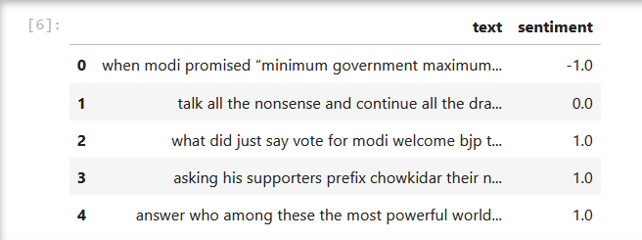
Dataset

Slide 5
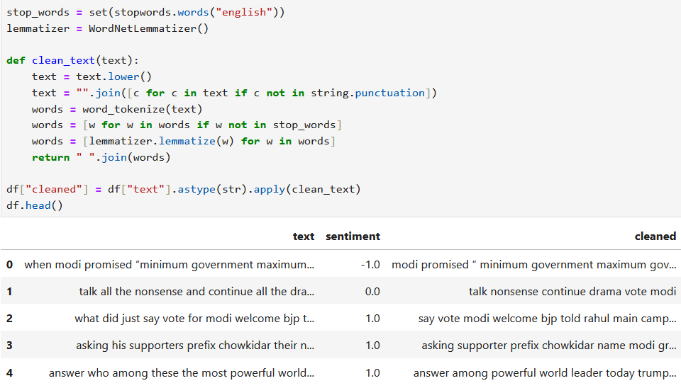
Data Preprocessing:
Convert text to lowercase
Remove punctuation
Tokenization (split text into words)
Remove stopwords
Lemmatization (convert words to base form

Slide 6

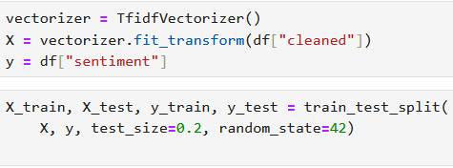
Feature Extraction:
TF-IDF Vectorization:
Converts text into numerical values
Measures importance of words in each comment
Used as input for Machine Learning models

Slide 7
Machine Learning Models Used:
We trained and compared multiple models:
Logistic Regression
Naive Bayes
Decision Tree
Support Vector Machine (SVM)

Slide 8
Logistic Regression:
What is Logistic Regression:
Logistic Regression is a supervised machine learning algorithm.
It is mainly used for classification problem

Slide 9
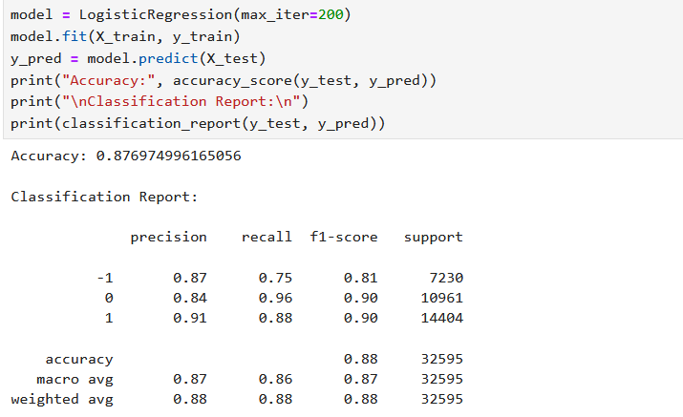
The code for Logistic Regression to calculate the accuracy of the model in Dataset:

Slide 10
Logistic Regression:
Logistic Regression Accuracy : 0.876
means :
The model achieved only 87.6 % accuracy.
That is to say:
The model correctly predicts in only 87.6% of cases.
And it incorrectly predicts in 12.4% of cases.
“This means the model is high for our Dataset.”

Slide 11
Naive Bayes:
Naive Bayes is a probabilistic machine learning algorithm.
It is widely used in text classification and sentiment analysis.
It works well with TF-IDF and Bag of Words features
It is fast, simple, and gives good results for text data.

Slide 12
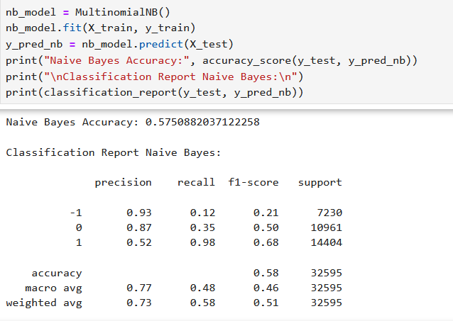
The code for Naive Bayes to calculate the accuracy of the model in Dataset:

Slide 13
Naive Bayes:
Naive Bayes Accuracy : 0.575
means :
The model achieved only 57.5 % accuracy.
That is to say:
The model correctly predicts in only 57.5% of cases.
And it incorrectly predicts in 43.5% of cases.
“This means the model is good for our Dataset.”

Slide 14
Decision Tree:
Decision Tree is a supervised machine learning algorithm.
It works by splitting data into branches based on feature values
It is easy to understand and visualize.
In this project, it was used to classify sentiment into positive, negative, or neutral.

Slide 15
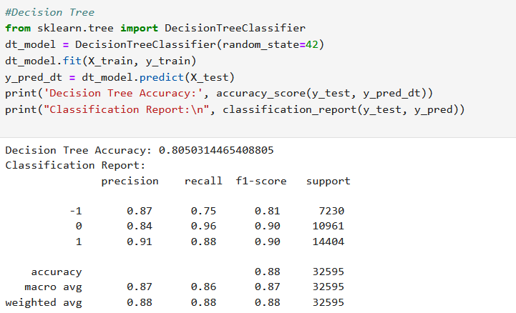
The code for Decision Tree to calculate the accuracy of the model in Dataset:

Slide 16
Decision Tree:
Decision Tree Accuracy : 0.805
means :
The model achieved only 80.5% accuracy.
That is to say:
The model correctly predicts in only 80.5% of cases.
And it incorrectly predicts in 19.5% of cases.
“This means the model is high for our Dataset.”

Slide 17
Support Vector Machine (SVM):
SVM is a supervised machine learning algorithm used for classification.
It works by finding the best separating boundary between different classes.
SVM performs very well with text data and high-dimensional features like TF-IDF.
In this project, SVM achieved the highest accuracy.

Slide 18
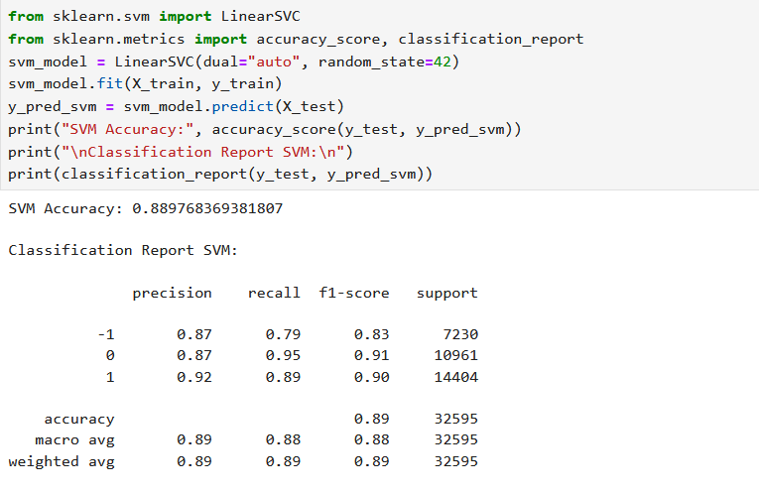
The code for SVM to calculate the accuracy of the model in Dataset:

Slide 19
Support Vector Machine (SVM):
SVM Accuracy : 0.889
means :
The model achieved only 89.9% accuracy.
That is to say:
The model correctly predicts in only 89.9% of cases.
And it incorrectly predicts in 10.1% of cases.
“This means the model is high for our Dataset.”

Slide 20
Confusion Matrix:
Confusion Matrix is used to evaluate classification performance.
It compares actual and predicted labels and shows correct and incorrect predictions.

Slide 21
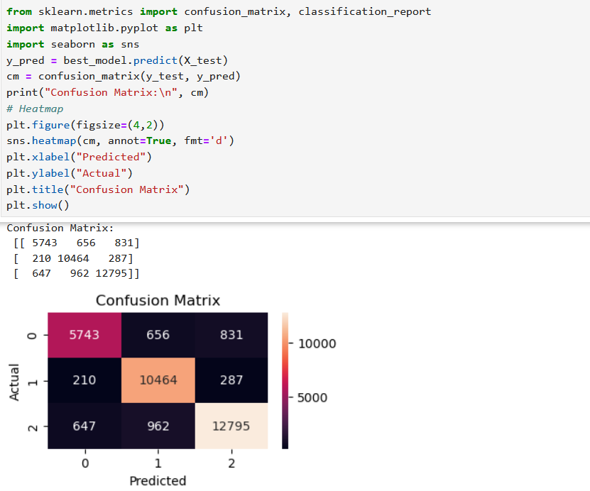
Confusion Matrix:

Slide 22
User Interface (Gradio):
A user-friendly interface was created using Gradio.
The user can enter any text comment.
The model predicts the sentiment instantly.

Slide 23
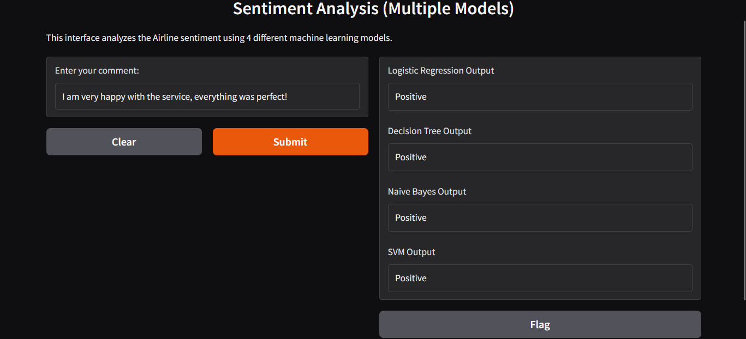

Slide 24
Conclusion
Sentiment Analysis helps understand customer opinions
Machine Learning provides accurate predictions
SVM achieved the best results
The project can be extended for real-time applications

Slide 25
Thank you

Slide 26
Team:
Nada Ebrahim
Malak Ebrahim
Yasmine Akram

